Slide 1
IMDb Crawler
and
Data Visualization
A Case Study Based On “The Shawshank Redemption”
Presenting by Team “We Tried”
Yaqing Peng Muyun Ji Ruilin Tao Shuang Deng

Slide 2
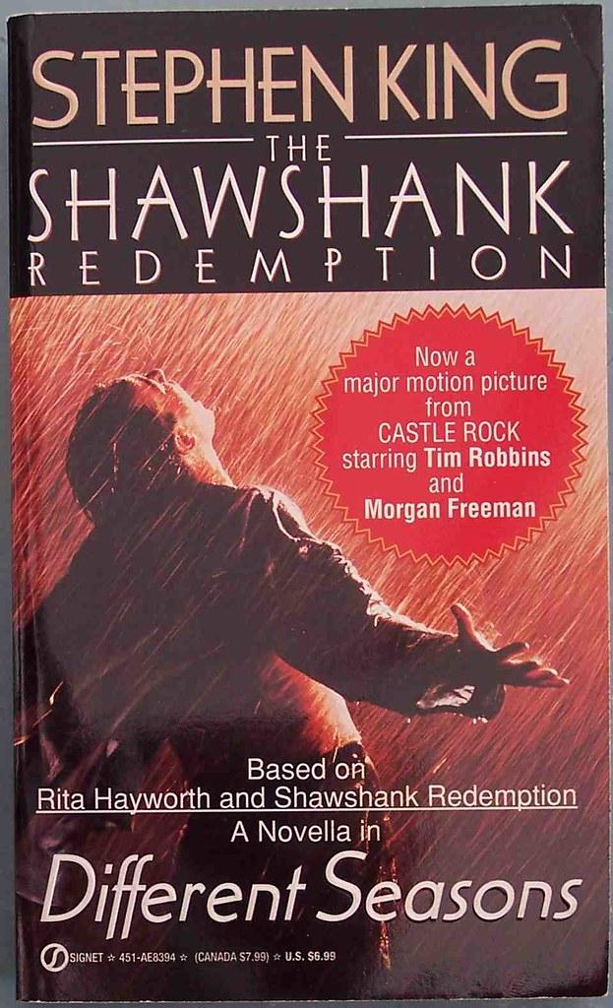
INTRODUCTION
About the Project
About Our Team
We aims to collect and visualize data from IMDb, a popular online film database.
1. Crawl reviews of The Shawshank Redemption and store that data in a CSV file, of which the code can be adapted to crawl reviews for any film on this website.
2. Through data analysis and visualization, our analysis dimensions and visualization methods can be applied to any other films.
Each team member share a similar amount of workload and contribution.
 | Main Code | Code Review
Web Scrape | Muyun Ji Yaqing Peng | Shuang Deng Ruilin Tao
Data Visualize | Shuang Deng Ruilin Tao | Muyun Ji Yaqing Peng

Slide 3
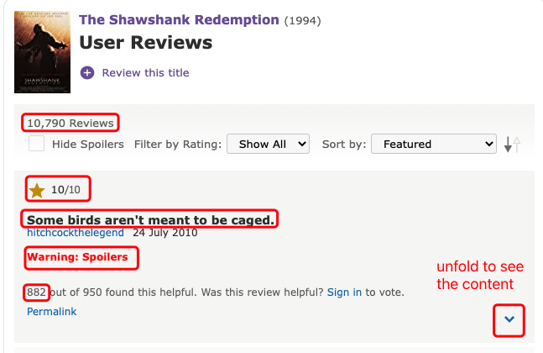
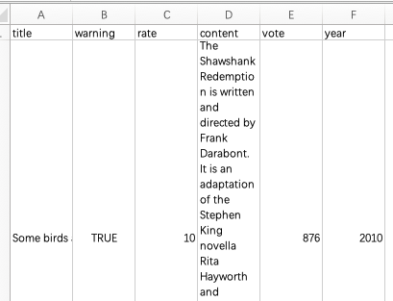
Web scraping
Key :
Learn how to scrape a web page from scratch
Save it into a CSV file.
Resources:
Learned how to use Selenium and WebDriver to crawl a web page through a video on Bilibili.
Learned how to extract tags from the HTML source code by searching on Google.
Steps:
First, load all pages of an IMDb webpage while expanding the collapsed contents;
then, read the target contents and write them to the CSV file row by row.

Slide 4
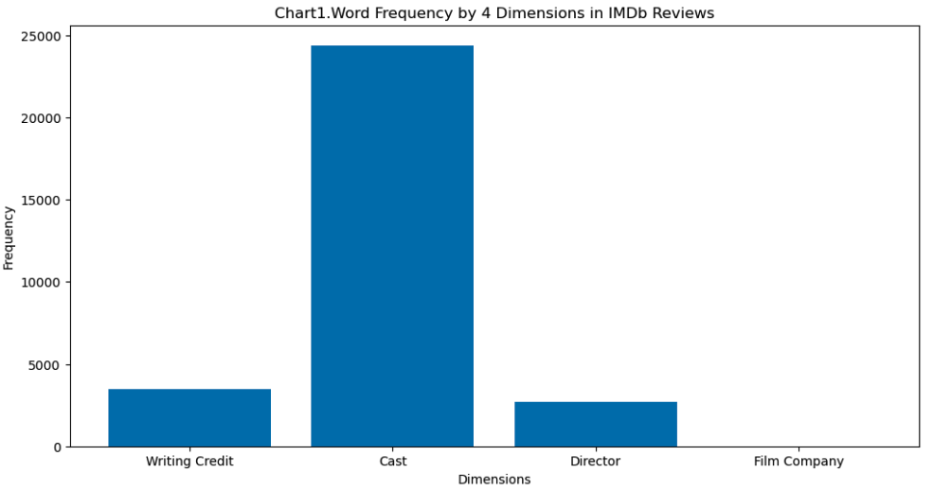
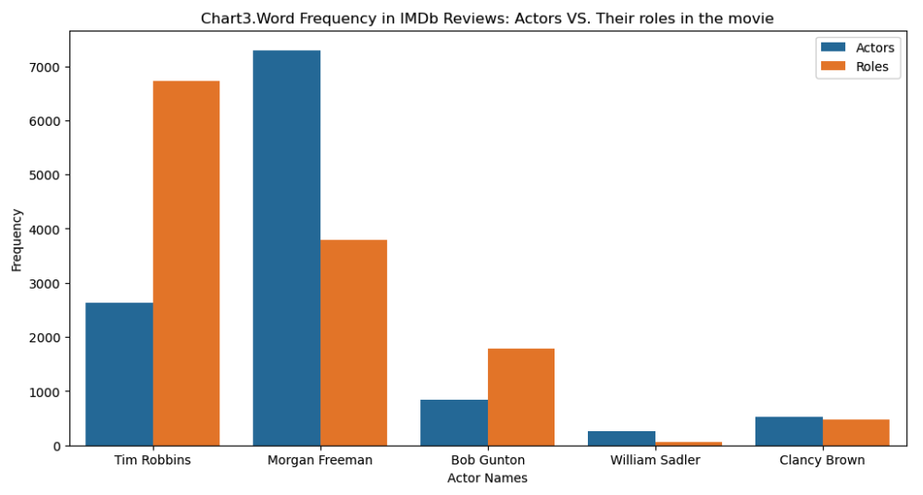
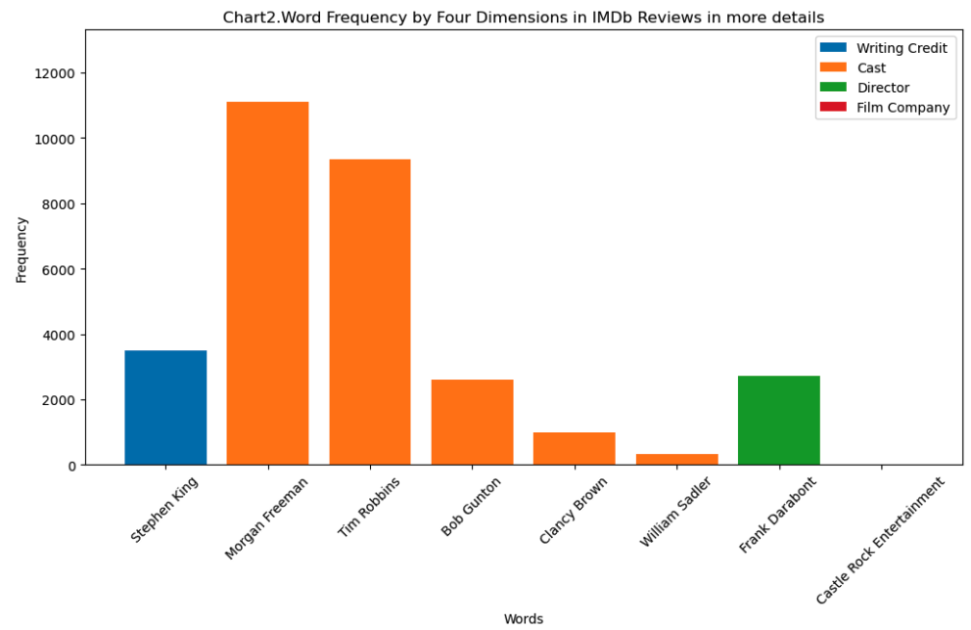
P1. Review Analysis: Four Dimensions

Slide 5
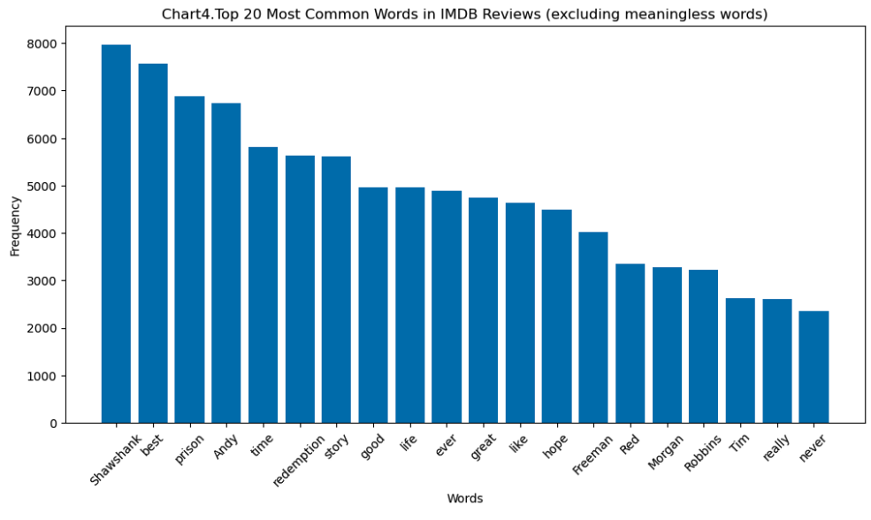
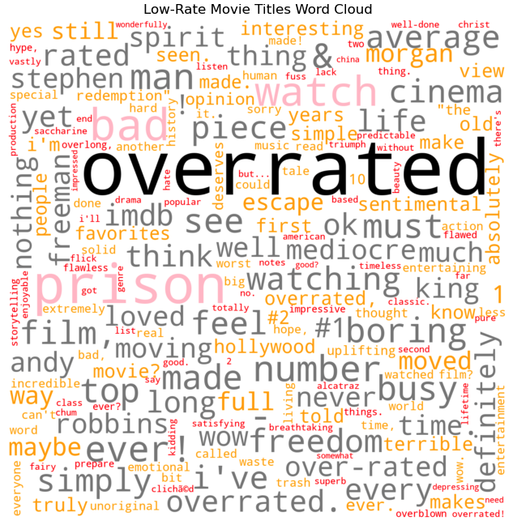
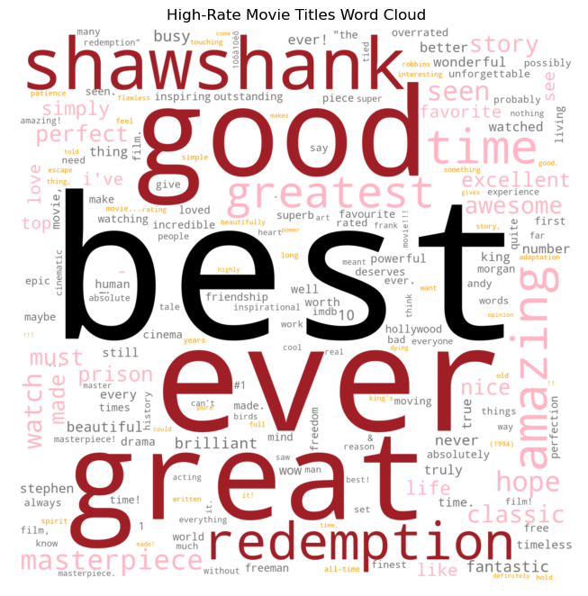
P2. High Frequency Words & Word Clouds

Slide 6
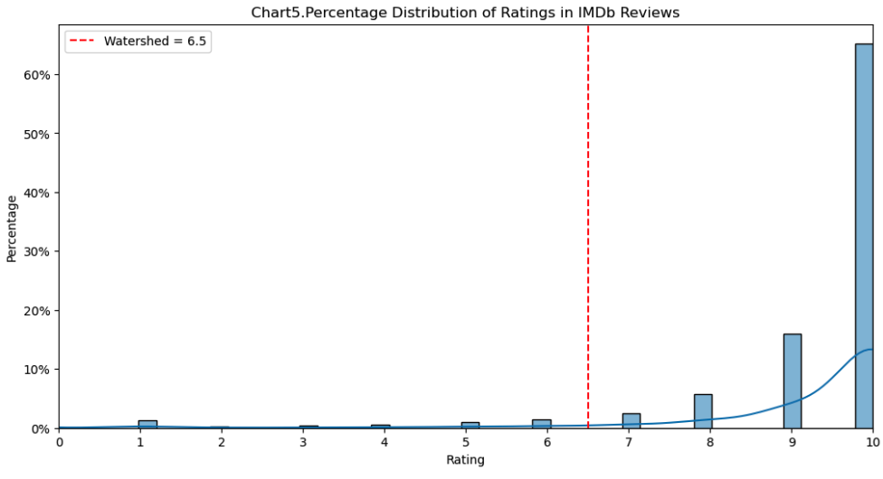
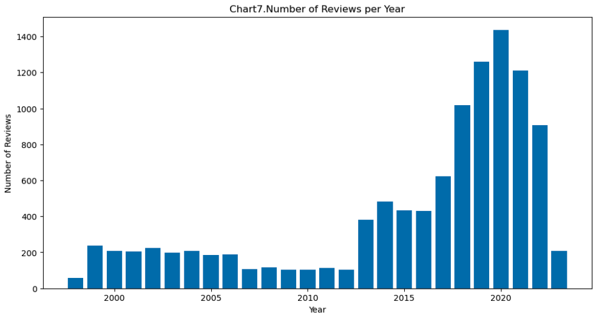
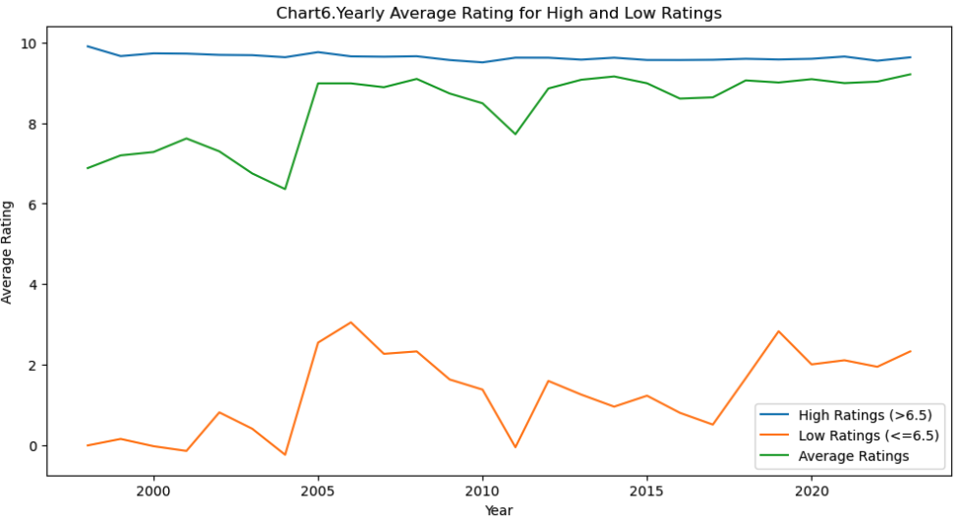
P3. Rating Trends & Influential Factors

Slide 7
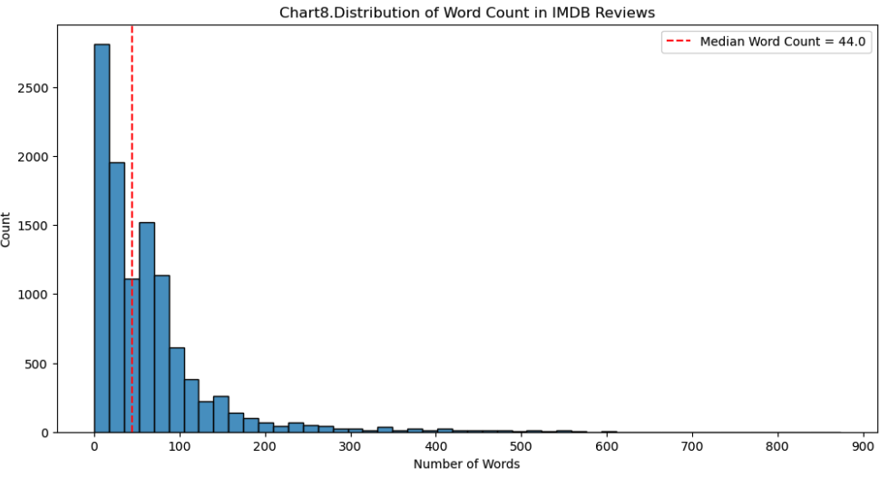
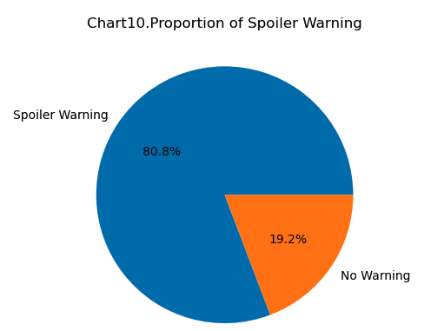
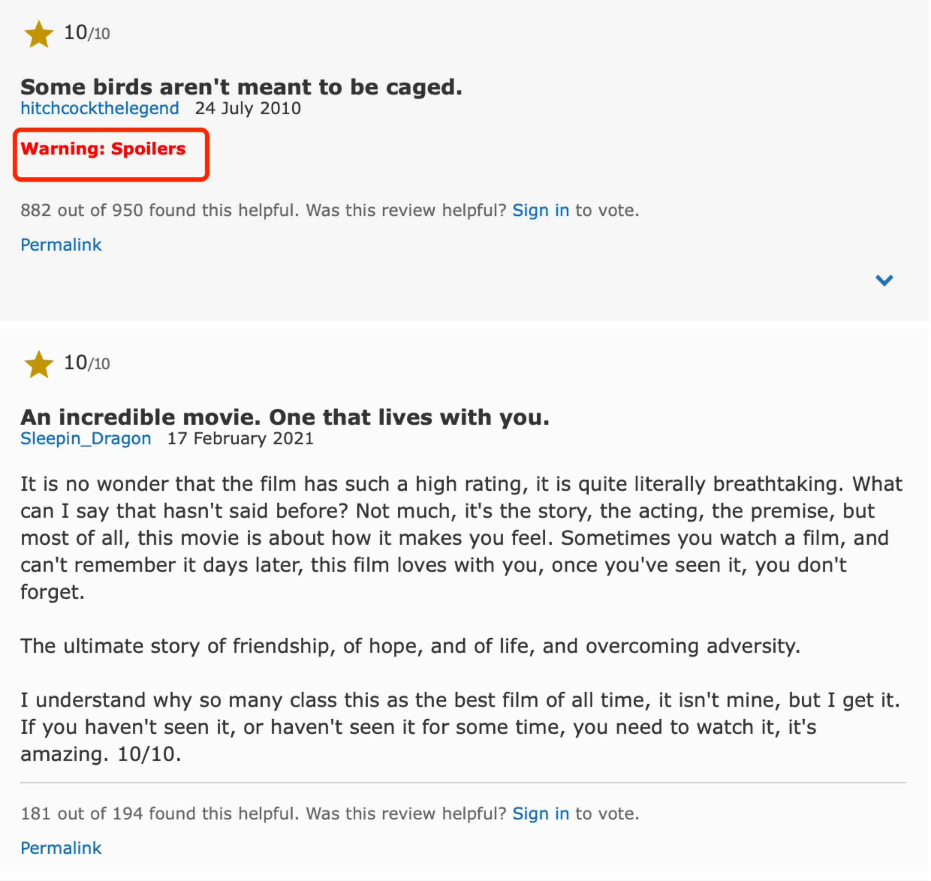
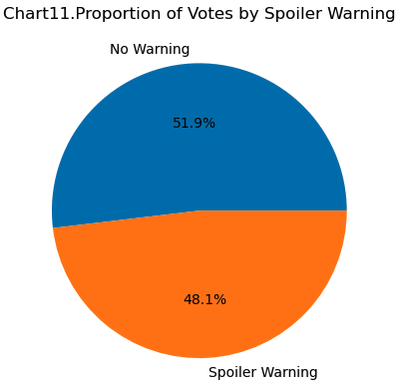
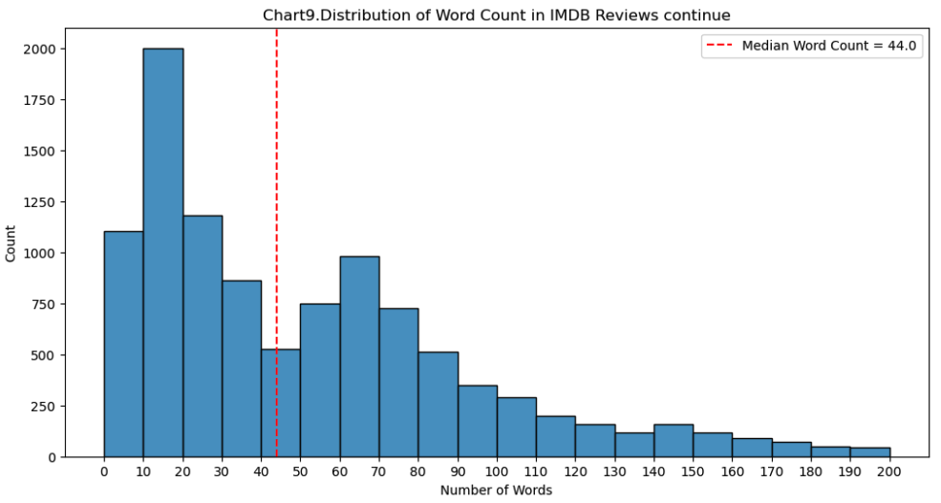
P4. Review Length & Spoiler Warnings

Slide 8
Conclusion
Through data analysis and visualization, we were able to uncover deeper insights hidden within the movie reviews:
1. Actors are most discussed in the reviews, followed by writers and the director, while the production company is rarely mentioned.
2. Reviews frequently use character-related, plot-related, and praise-focused words. High-rating reviews often use praise-focused words i.e. "Best" and "Great" etc., while low-rating reviews feature negative terms i.e. "Overrated", "Boring", etc.
3. Ratings are polarized, dominated by either near-perfect or low scores, which has remained consistent over time. A significant increase in the number of reviews can be observed be 2013 and 2019.
4. People favor writing shorter reviews less than 200 words. But data suggests they may slightly enjoy reading non-spoiler-warning reviews more.

Slide 9
Thank you!
Our group's name is "We Tried."
We tried for project ideas, we tried for the API application, we tried for scraping data, we tried for data analysis and visualization, we tried for summary and presentation, and we tried for teamwork, putting in a lot of effort.
As a group, we are proud that we have tried them all together!

